Slide 1
Basic Intro to Hadoop + MapReduce
Women in Data Science
Workshop on Hadoop, MapReduce & Spark
June 15, 2017

Slide 2
Hadoop Ecosystem is Complex, but was created to distribute calculations of very large datasets in a storage format called Hadoop File System (HDFS) + MapReduce

Slide 3
MapReduce: An Oldie but (sometimes) A ‘Goodie’
Helpful for very simple calculations (additions, subtractions, non-iterative calculations) of large datasets
Draws data from HDFS
Is created to distribute the data calculations and create ‘fail-over’, with a ‘shuffle’

Slide 4
But you don’t need Hadoop to perform a MapReduce!

Slide 5
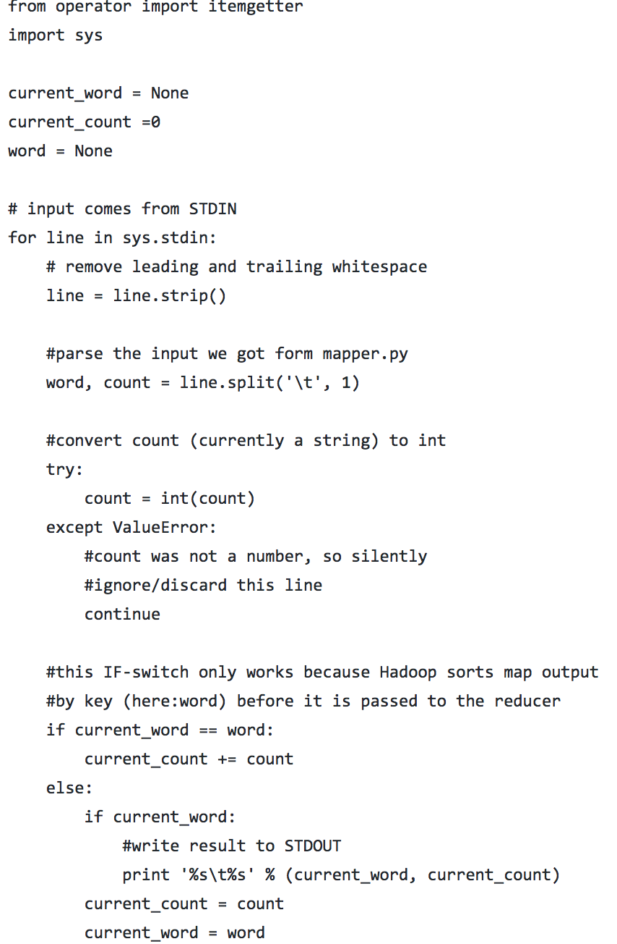
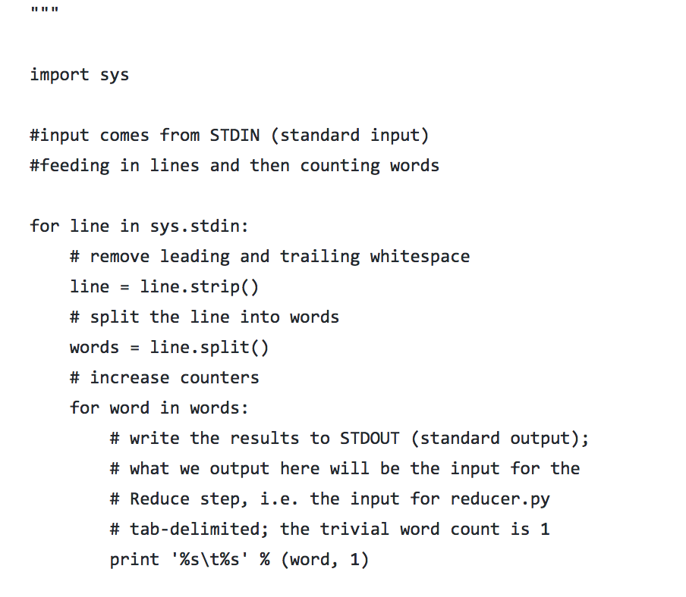
Code is simple, use a std.in and std.out and shuffle in between

